Slide 1
Osu! Beatmaps Popularity Analysis
- Hoyin Chu

Slide 2

What is Osu?
“Osu! is a free rhythm game where the player chooses a song and a difficulty from a list of downloaded "beatmaps" . As the song plays, the player must click on different hit-elements (hit circles, sliders, and spinners) in time with the rhythm of the song in order to earn points.”
-- Wikipedia (https://en.wikipedia.org/wiki/Osu!)

Slide 3
Basic rules of the game
A health bar is given at the start of every beatmap
As the song plays the health bar will begin to drain
Clicking on the circles at the right time will gain health
Missing them would lose health
Goal of the game is to reach the end of song without failing (reaching 0 health)

Slide 4
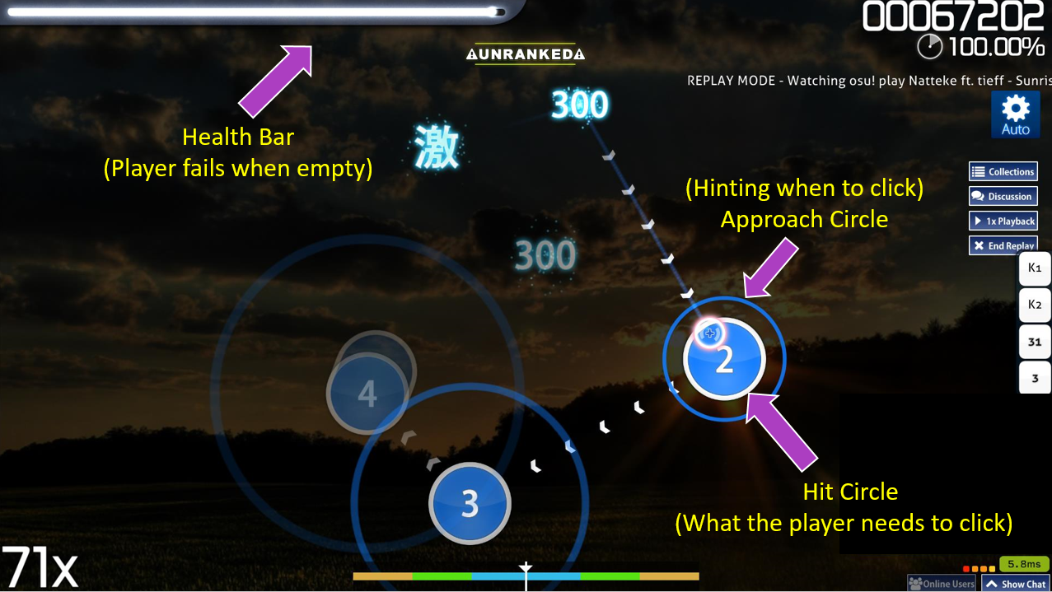
What does a beatmap look like?

Slide 5
How does the gameplay look like
https://www.youtube.com/watch?v=pBgn--Ve2WU
Or just search up “osu” on youtube (Not Ohio State University)

Slide 6
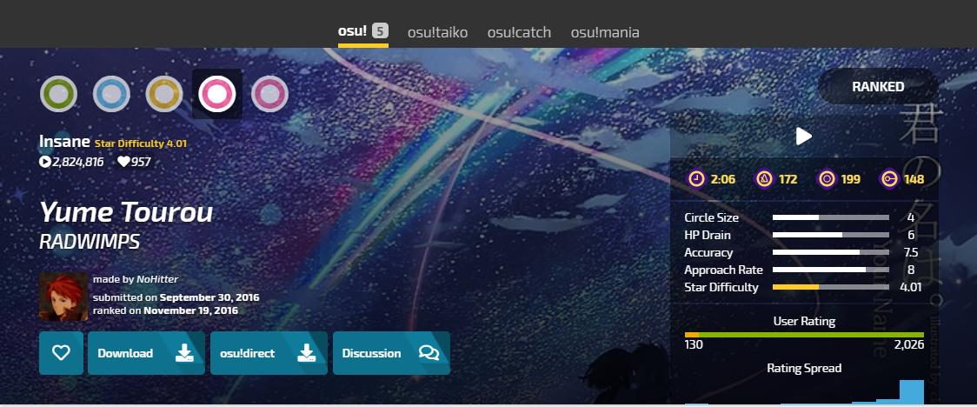
What are the Properties of a beatmap (and beatmap sets)
Some properties of a beatmap include
HP Drain: the rate at which the health bar decreases
Approach Rate: the speed in which the ring approaches the circles
To accomadate players at different skill levels, a song may have more than one beatmaps.
Such collection is called a beatmap set.

Slide 7
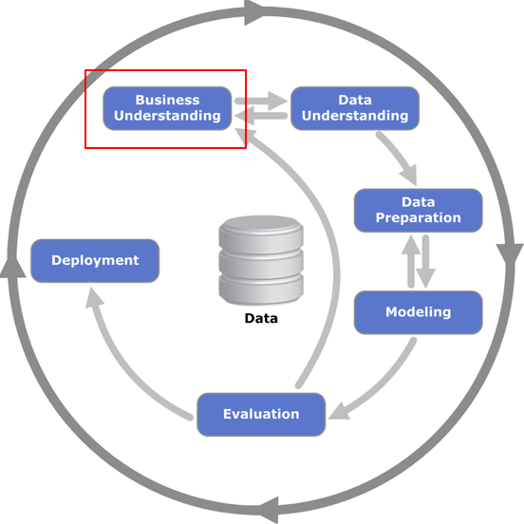
Motivation
Every beatmap in the game is made by the community, there are no “official beatmaps”
But some beatmaps are being played a lot more than the others, what makes a beatmap popular?
Getting the answer would allow beatmap creators to make maps that suits more players’ interests, improving the overall experience.

Slide 8
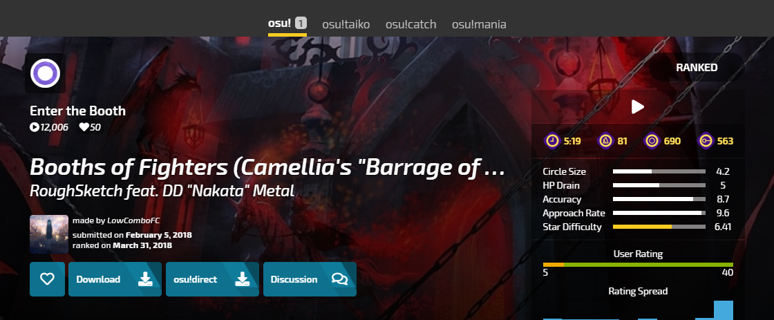
how do we measure popularity
Three candiates: Play Count, User Favorite, User Rating
Neither favorite or rating functions are commonly used
User can play a beatmap as many times as they want, a more natural representation of popularity
Therefore we choose play count to measure popularity

Slide 9
How to make the measure fair (Normalized)
It is reasonable to assume that beatmaps that are approved earlier will have higher play count
Therefore to make sure popularity is evaluated fairly we will measure by the average play count per day
“Day” being the number of days since it has been approved

Slide 10

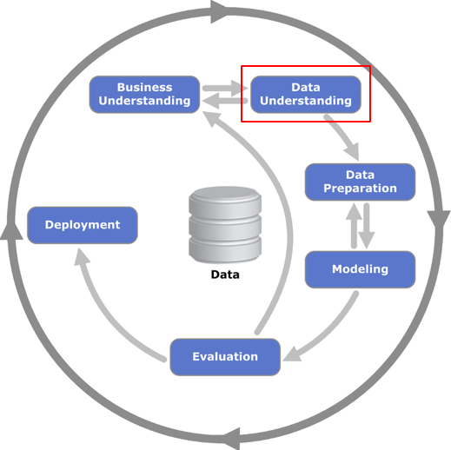
What do we need
We need to know the different properties of a beatmap
We need a list of recently approved beatmaps so our result can reflect the most recent community

Slide 11
What was attempted
Make a custom web scraper that scrap off the url to the 1000 most recently approved beatmapsets from the official osu! beatmap website
Then within the url scrap the data that are related to the properties of the website

Slide 12
Why it did not work
The site has infinite scroll -> harder to scrap
Each url leads to a beatmap set, need to click on each beatmap in the set to get the properties of individual beatmaps -> even harder to scrap
Beatmapsets may contain beatmap for other game mode
Very time consuming

Slide 13
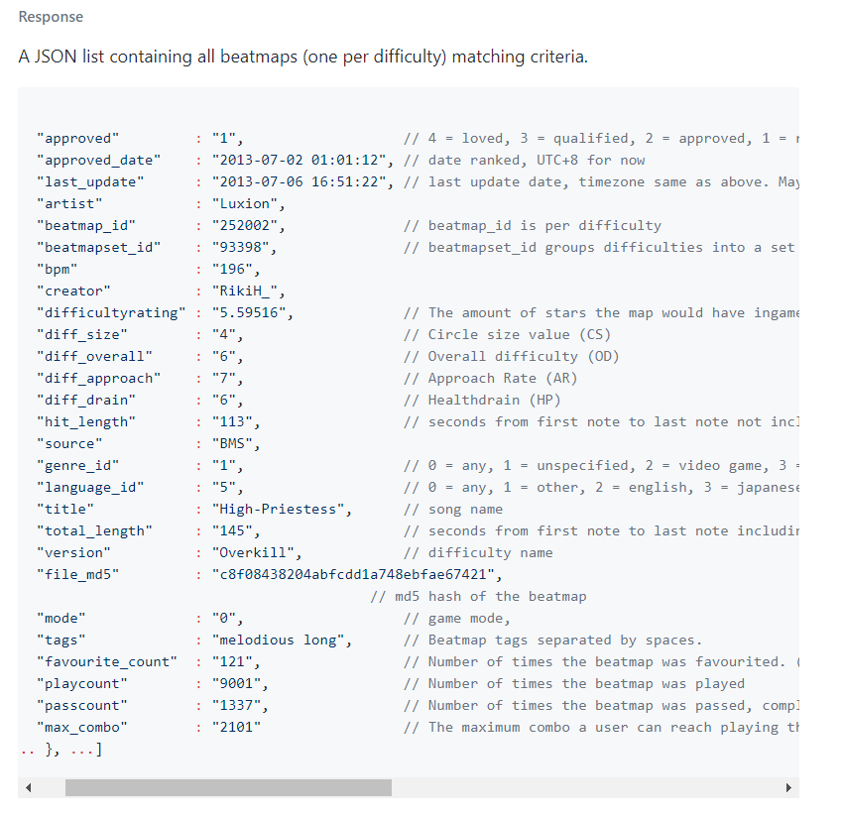
Alternate solution
By using the official osu! API, we can get a list of 500 latest approved standard mode beatmaps, along with their properties
https://github.com/ppy/osu-api/wiki

Slide 14
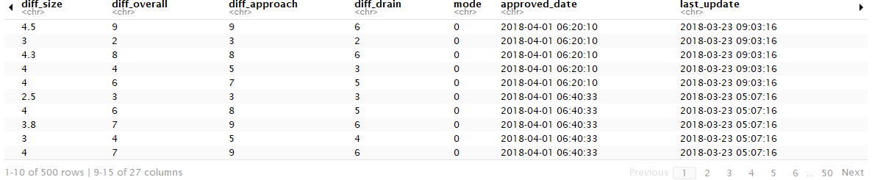
Data Acquisition (Collected on April 15th, 8:00pm)
Using R to make a call to the API and get the JSON objects
Using the jsonlite package to parse the JSON objects to a dataframe
For now, we will store the data in a CSV file for further usage.
See R Notebook “CHU_H Final Project Step One Data Acquisition” for implementation details

Slide 15
What is in the data
Before we do any data shaping, we may want to explore our data to get a good sense of what is going on so when we are constructing our model later we can keep in mind that there may or may not be underlying issues with our data.

Slide 16
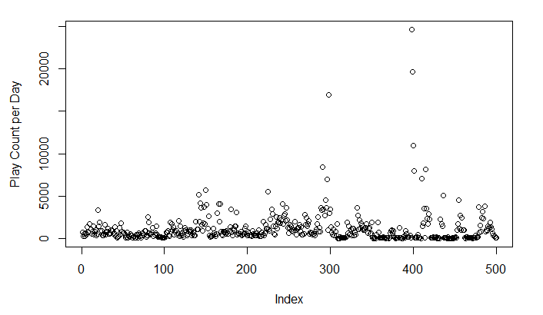
Exploratory data plotting
By plotting the play count per day value for every beatmap, we discovered that aside from a couple data points, most play_count per day do not exceed 10000. So we should perform outlier detection and take note of what data are outliers

Slide 17
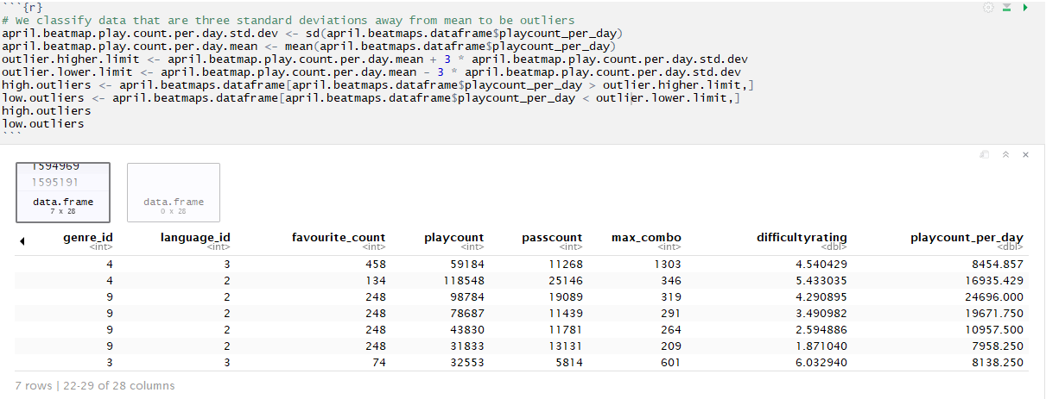
Outlier detection
By classifying data that are three standard deviation away from the mean to be outliers, we found 7 outliers and we will record these outliers in a CSV for future references
See R Notebook “CHU_H Final Project Step Two Data Exploration” for implementation details

Slide 18
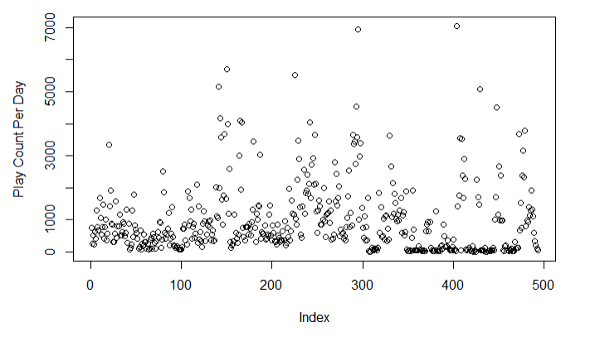
How does plot look like now
With outliers removed we can still notice a pattern where most plots are concentrated in the lower part of the graph.
This prompt us to create a frequency histogram

Slide 19
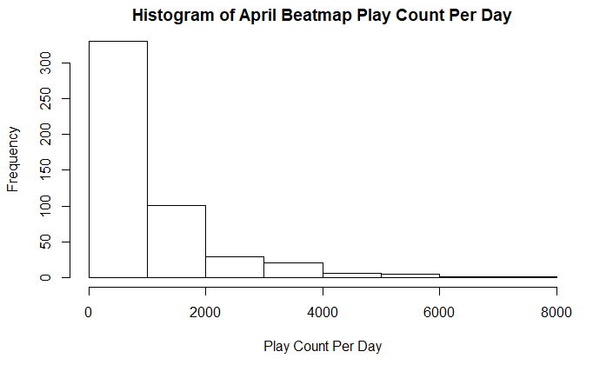
Skewness of data
From the histogram we found our data to be positively skewed
This means when we are building our model we should probably apply some kind of transformation
Or build a model that does not assume normal distribution

Slide 20
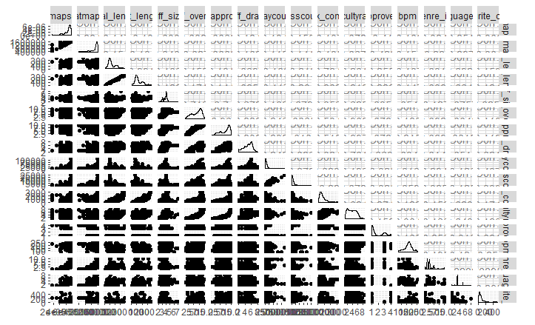
Colinearity analysis
We also see a very strong linear correlation between the feature total_length and hit_length
We suspect that there is a correlation between the two features

Slide 21
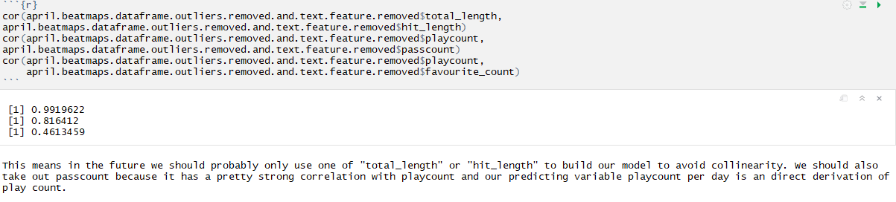
How to confirm our suspicions
From the collinearity diagram and our domain knowledge, we suspect that there are correlations between total_length and hit_length, play_count and pass_count, favorite_count and play_count
By looking at the correlation coeeficient, out first two suspicions are confirmed while the last one is not

Slide 22
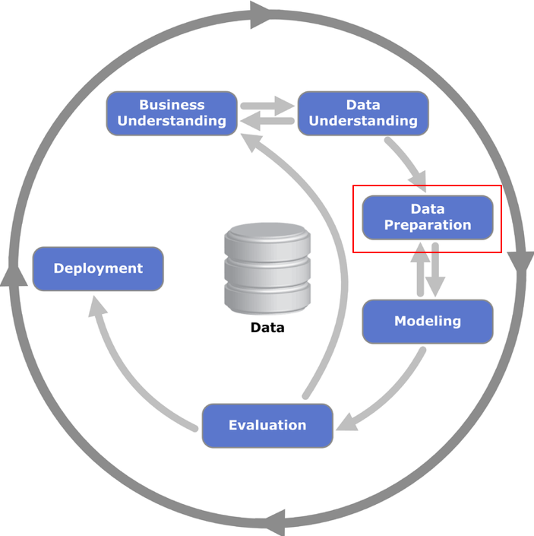
How are we storing the data
There are a lot of columns and we don’t need all of them to perform an analysis.
If we take out the columns we don’t want for this analysis in the CSV we are losing information that may be helpful in the future
To use the data more efficiently, we can store them in a relational database such as SQLite.
This way we can get only the data we want without losing information or loading information we don’t need.

Slide 23
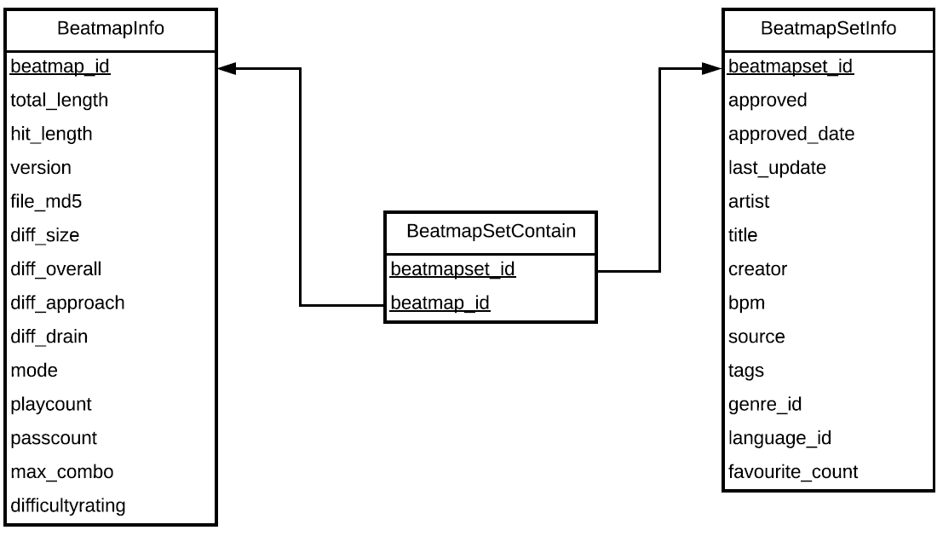
How are we storing the data
By constructing a schema that is in 3-Normalized-Form (3NF) we are guaranteed that no update anomalies will occur when we insert data in the future
Also makes retrieving data much easier since the schema diagram can tell us what tables to join and it tells us the relationships betweem properties
Beatmap_Schema.pdf

Slide 24
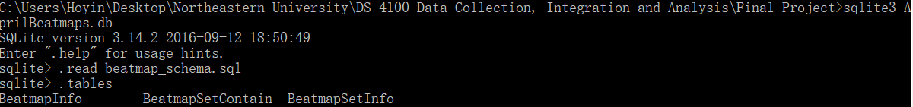
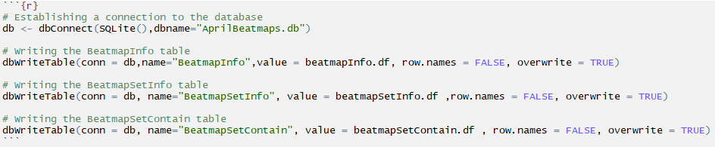
Data storage
First create the database by loading beatmap_schema.sql into sqlite3
To populate the tables, load columns in the CSV file to the corresponding tables using the RSQLite package
See R Notebook “CHU_H Final Project Step Three Data Preparation” for implementation details

Slide 25
WHAT data are we going to use
Since we are not going to focus on text analytic, text features are discarded
We only collected data from standard mode so ‘mode’ is unnecessary
‘last_update’ is not relevant

Slide 26
Can we take out more
Learning from data exploration, we should
Use only one of hit_length or total_length, we choose hit_length
Don’t use passcount

Slide 27
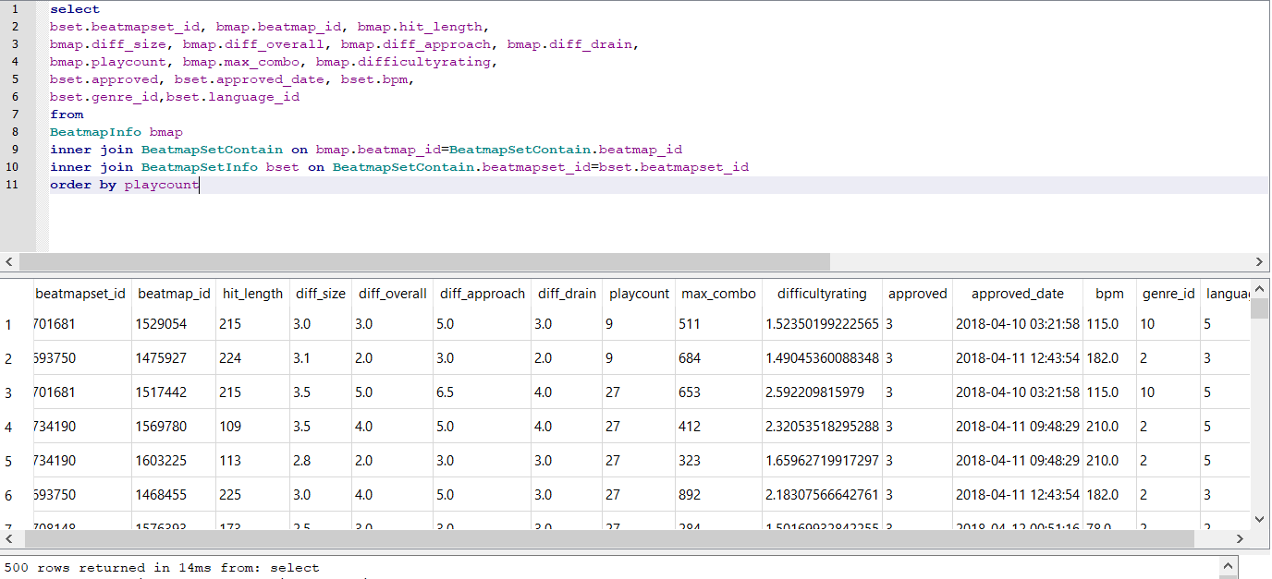
What are we getting back from the database

Slide 28
Data shaping
Dummy variables will be contructed for approved, genre_id and language_id since they are categorical
After inspecting the data we found:
There are 5 types of approved status but no status 0,2 so a total of 5 – 2 = 3 dummy columns are added
There are 10 types of genre but no genre id 0 or 6 so a total of 10 – 2 = 8 dummy columns are added
There are 12 types of languages but no language id 0, 7,9,10,11 so a total of 12 – 5 = 7 dummy columns are added
A total of 3 + 8 + 7 = 18 dummy columns are added

Slide 29
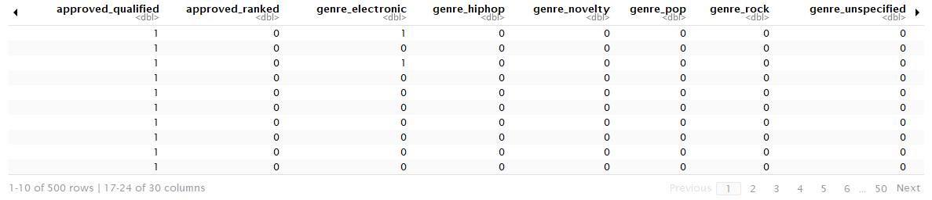
How does our dataframe look like now
See R Notebook “CHU_H Final Project Step Three Data Preparation” for implementation details

Slide 30
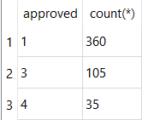
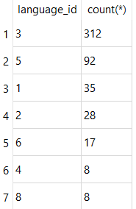
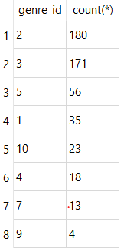
Reshape our data
confirm_approved_sparsed.sql
Looking back at the dataset, we discovered that many dummy columns are very sparsed and only certain features are popular
Therefore we are only going drop dummy columns that do not exceed at least 10% of our data (at least 50)
We should also drop one extra column from all categorical variables to avoid collinearity
confirm_language_sparsed.sql
confirm_genre_sparsed.sql

Slide 31
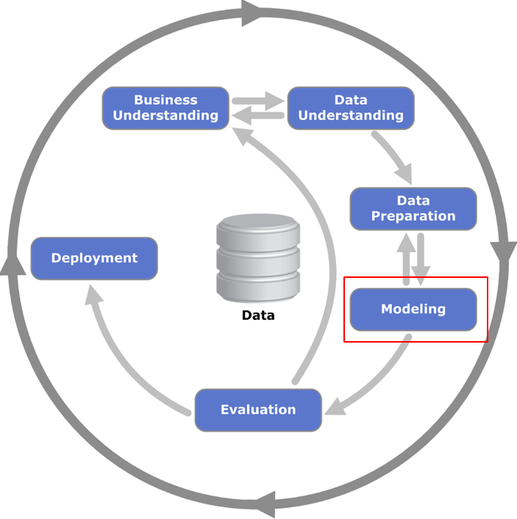
What models do we plan to use
Since we are predicting a numeric variable, we will use models such as:
K-Nearest Neighbor (kNN) Regression
Multiple Linear Regression (MLR)

Slide 32
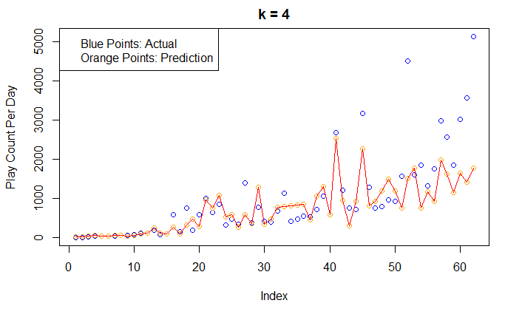
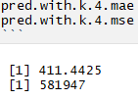
The knn regression model
We pick a k that is the square root of our dimensions, in this case it rounds to 4
Mean Absolute Error: 411.4425
Mean Square Error: 581947
To get a better sense of how the model is performing, we should also try out other k values (tuning the model)

Slide 33
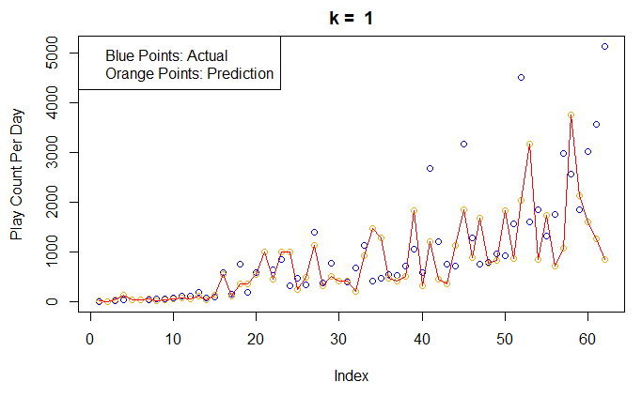
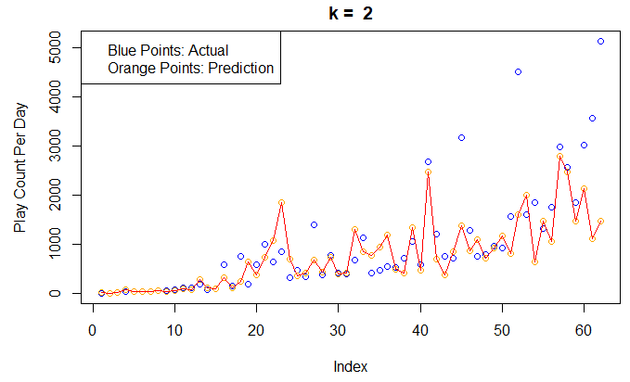
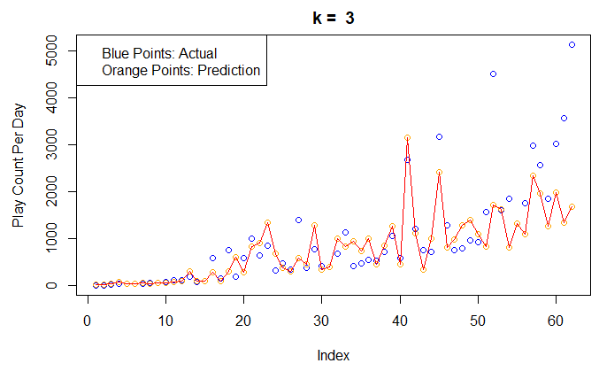
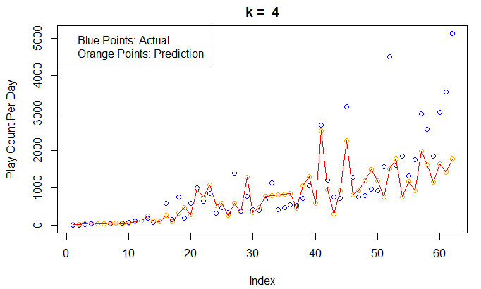
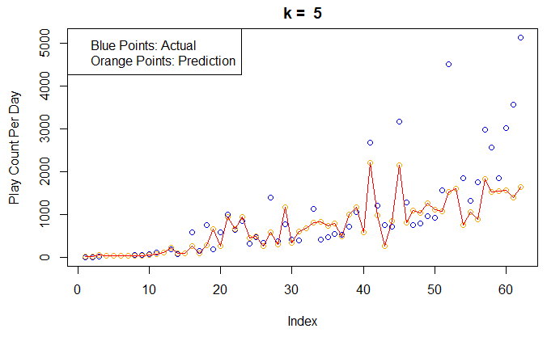
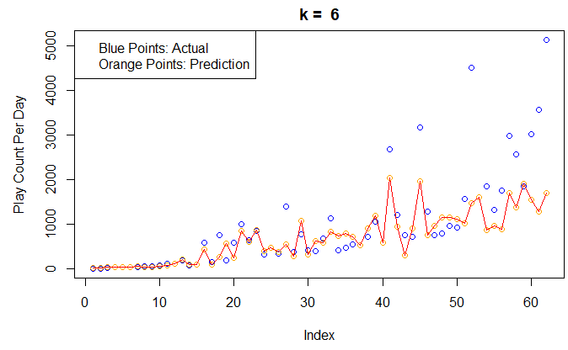
Which k to pick
More graphs in R Notebook “CHU_H Final Project Step Four Modeling and Evaluation”
We notice when k > 5 there is not much difference except the line gets tighter and tighter, so we are going to take a deeper look at the first 5

Slide 34
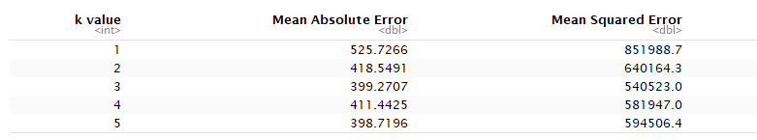
Which k to pick
Even though k = 5 has a slightly beeter MAE than k = 3, k = 3 has a much better MSE
By having a smaller k we allow a higher variance can do a better job at predicting data with high play count per day
Therefore 3 is the optimal k

Slide 35
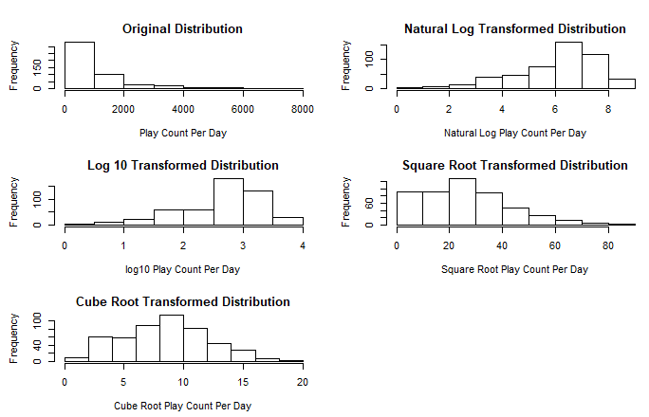
Multiple linear regression model
Recall from data exploration that our play count per day data is skewed
Therefore we should find a transformation that would normalize the data which is a prerequisite for a multiple linear regression model
Cube root transformation normalizes our data the best

Slide 36
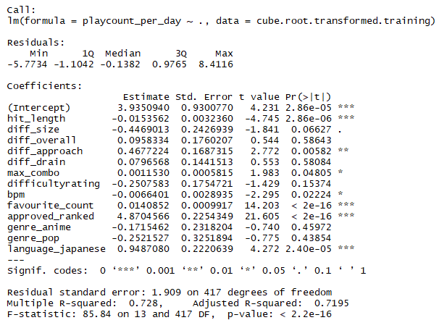
Initial multiple linear regression model
To improve our model, we can use the backward fitting method

Slide 37
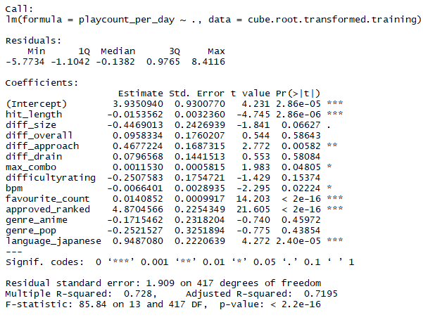
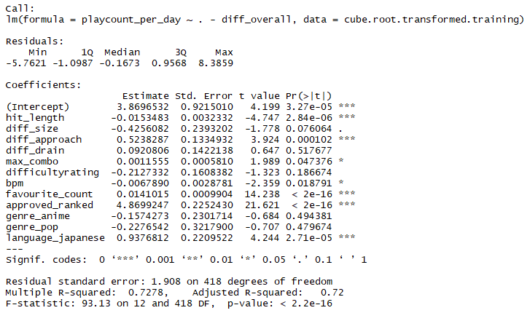
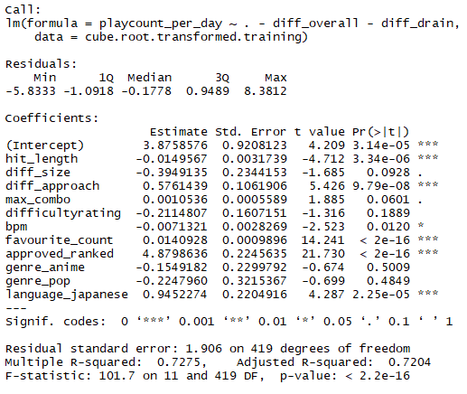
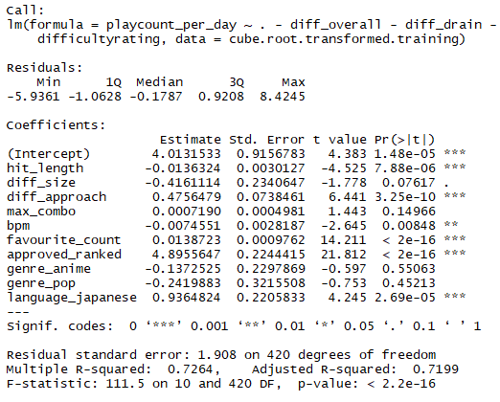
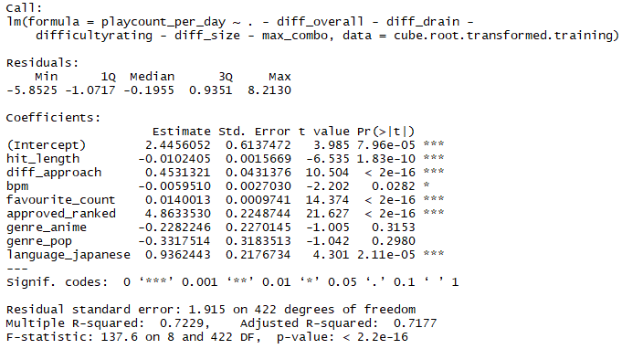
Removing insignificant features

Slide 38
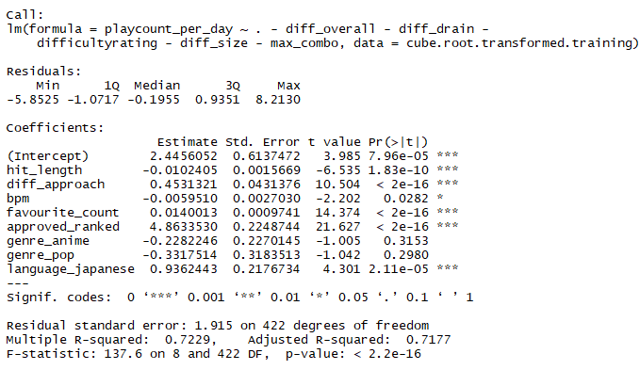
Final multiple linear regression model
Model has R-square > 0.70
All non-categorical feautres with p-value > 0.05 are removed

Slide 39
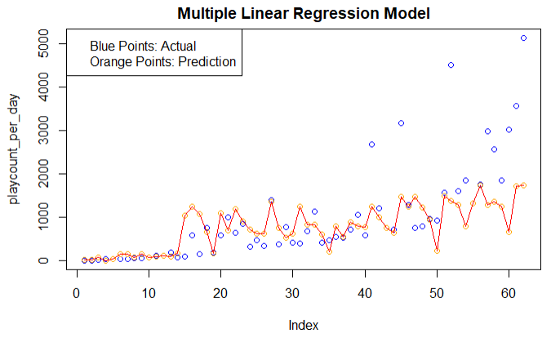
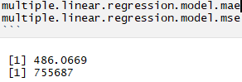
How well does it predict
Since we cube root transformed play count per day, we re-transform by cubing the predicted play count per day
Mean Absolute Error: 486.0669
Mean Squared Error: 755687

Slide 40
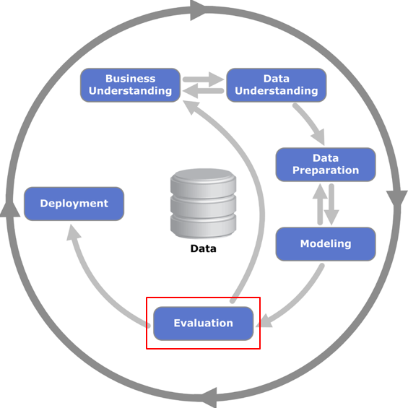
Model comparison: knn vs mlr
MLR has higher both Mean Absolute Error and Mean Squared Error
KNN makes no assumption of distribution of data and does not need transformation
KNN is superior in this case

Slide 41
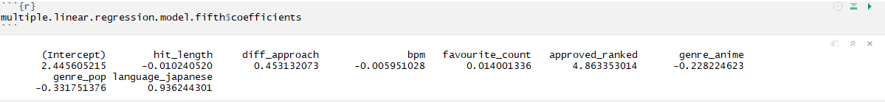
Is the mlr model useful at all
we can see what propoerties would make a beatmap popular thanks to the coefficients that multiple linear regression model brought up

Slide 42
Result analysis
If we order by coefficients, we can see that the most positively associated properties of a beatmap are:
approved_ranked -> language_japanese -> diff_approach -> favourite_count
and the most negative associated properties of a beatmaps ordered from least negative to most negative are:
bpm -> hit_length -> genre_anime -> genre_pop

Slide 43

Positive: Why approved_ranked
To get a beatmap ranked it needs to go through a lot of inspections and re-editing, which gurantees beatmap qulity.
The osu beatmap website is filtered by “ranked” by default
Ranked maps have a lot of exposure -> more plays

Slide 44
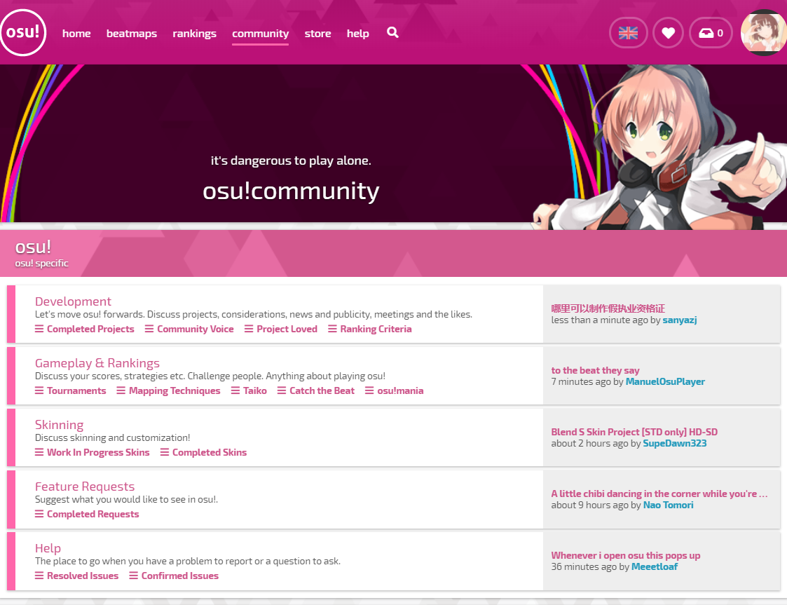
Positive: Why language_japanese
There have been a lot of overlap between the osu community and the anime community
Since most anime music are in japanese, it is natural that beatmap made from japanese song are more popular than the others.

Slide 45
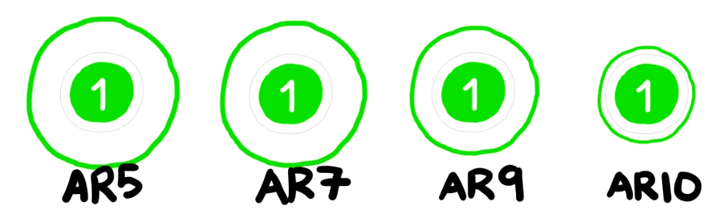
Positive: Why diff_approach
diff_approach refers to a mechanic in the game called "approach rate" which indicates how fast the ring appraoches the circle
From this we can see that players seem to enjoy beatmaps with higher approach rate than lower.
Image source: https://www.youtube.com/watch?v=R-cvHNt1gJQ

Slide 46
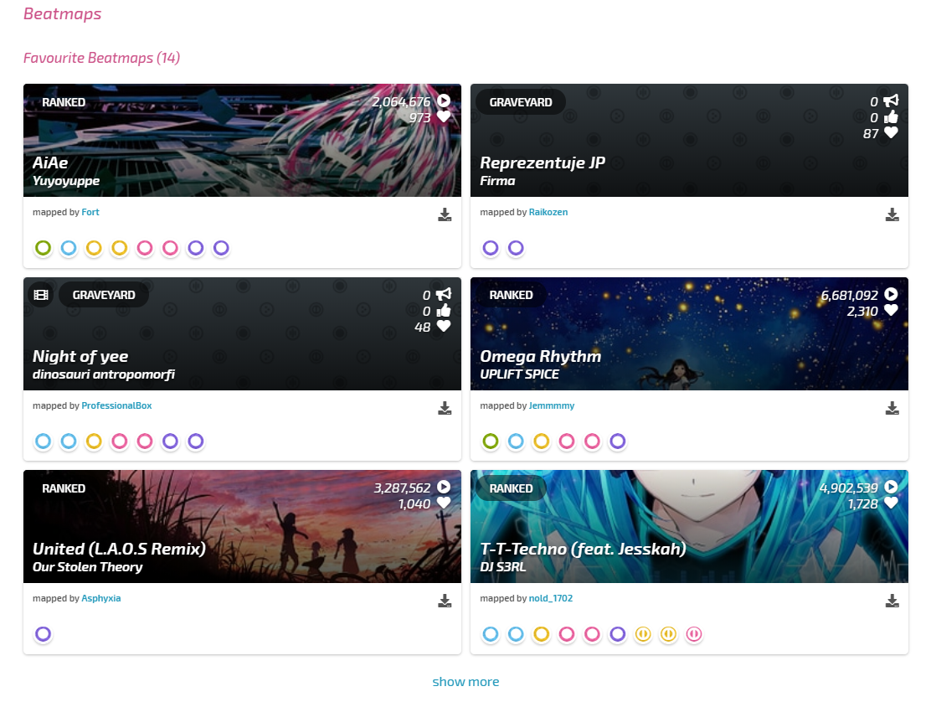
Positive: Why favourite_count
favorite_count refers to the number of players that marked the beatmap as favorite
It seems like the more player that mark a beatmap as a favorite, the more likely that some other player would like to play.

Slide 47
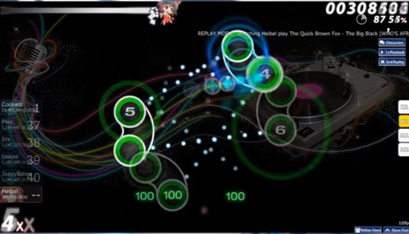
Negative: why bpm
bpm stands for beats per minute, a high bpm means the song is fast and vice versa.
From this we can see that people seem to enjoy beatmaps that are slower rather than faster.
A guess is slower beatmaps are easier than faster songs so more people can play them

Slide 48
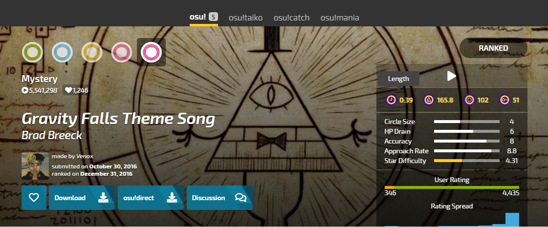
Negative: why hit_length
hit_length stands for the time between the first hit object appears and the last hit object appears
It can be roughly translated to the length of the song.
A similar guess is shorter songs are easier to play than longer ones

Slide 49
In conclusion
The "ideal beatmap" to a player, or a beatmap that would gain the most play count per day, would have the following property:
Is ranked
Is in Japanese
Has a high approach rate
Has been liked by other players
Is a slower song
Is short

Slide 50
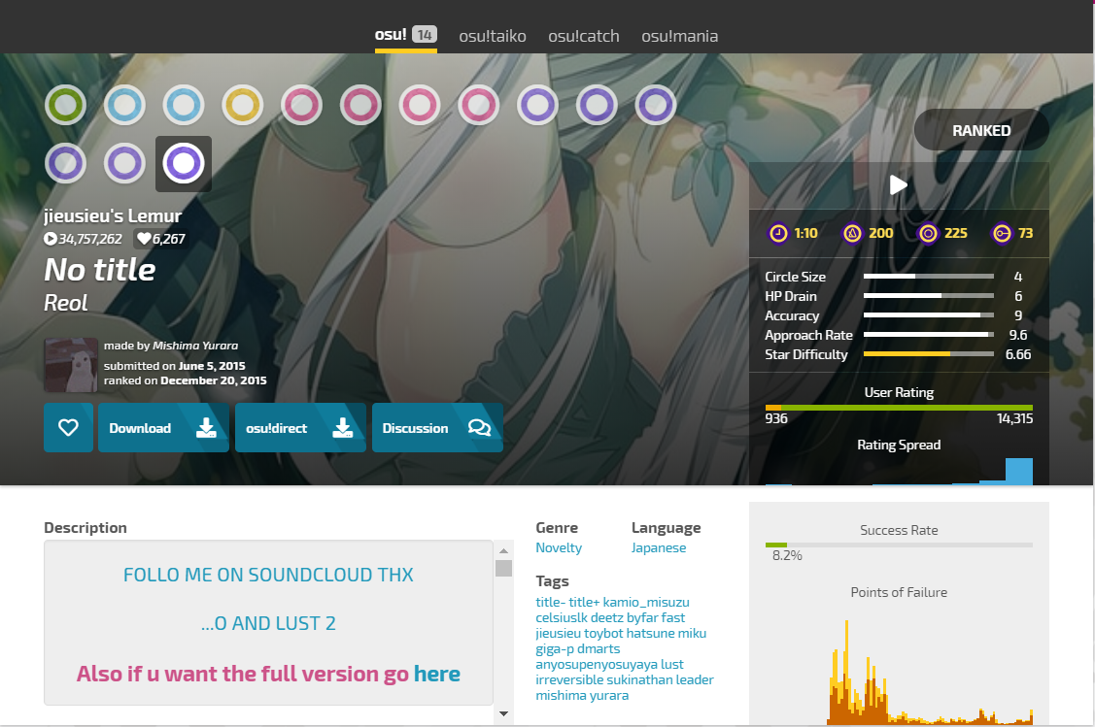
Fun fact
The most played beatmap in osu! so far, besides the default song, is named “No Title” by Reol
The beatmap matches 5 out of the 6 properties we proposed
Is ranked
Is in Japanese
Has a high approach rate (9.6 / 10)
Has been liked by other players
Not a slow song (bpm is 200, which is > than average bpm in our dataset)
Is short (only 70 seconds, average length in dataset is 141 seconds)

Slide 51

Citation
CRISP-DM Diagram: By Kenneth Jensen - Own work based on: ftp://public.dhe.ibm.com/software/analytics/spss/documentation/modeler/18.0/en/ModelerCRISPDM.pdf (Figure 1), CC BY-SA 3.0, https://commons.wikimedia.org/w/index.php?curid=24930610

Slide 52
THAnks for watching!

